Slide 1

Stock Master : Know stocks in your local currency!
Ari and Yash

Slide 2

Project Context and Business Goal
Context:
The project aimed to create a data pipeline for live dataset extraction and loading into a relational database through ETL/ELT processes. The primary goal was to format the data in a user-friendly manner for quick engagement by analysts and scientists, achieved by loading it into distinct tables with clear column names and appropriate data types.
Business Goal:
The project aims to create analytical datasets using the Market Stack API and Fixer API to provide comprehensive stock data and exchange information in local currencies for investors

Slide 3
Dataset Selected
Market Stack API: Market Stack is a powerful API that provides real-time, intraday, and historical market data for global stock markets. It's widely used for accessing up-to-date stock price information in various formats.
Fixer API: Fixer API is a popular service that provides real-time and historical exchange rate data for a wide range of currencies. It’s widely used for currency conversion applications.
Postgres: Progress is used for storing store data from API, transformation of data and loading the results for traders to access using SQL. Analyst can use the SQL to build a report/dashboard for analysis.

Slide 4
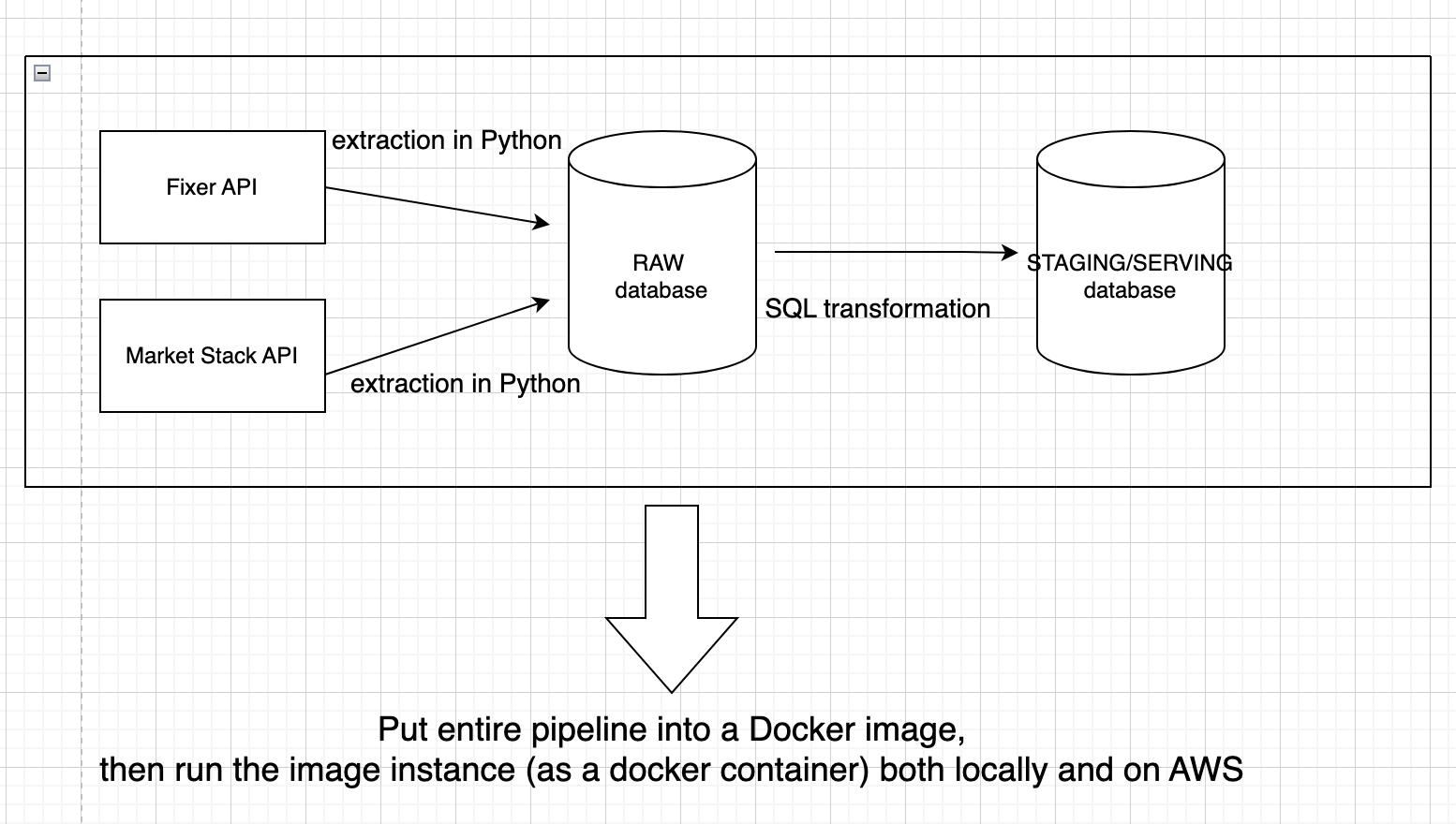
Solution Architecture

Slide 5
ETL/ELT technique used
ETL-TL (Extract, Transform, Load) is the primary tool used in our project for data integration and processing.
We utilized the Live Market Stack and Fixer API to effectively load raw data and performed upsert operations.
The raw data was extracted and transformed for serving using incremental techniques, ensuring efficient data refresh.
We employed more than 7 transformation techniques, including data cleansing, aggregation, and normalization, to prepare the data for serving.
The processed data was loaded into PostgreSQL for storage and accessibility.
A comprehensive image of the entire ETL pipeline was created using Docker Compose and AWS services for seamless integration and deployment.
The pipeline image was seamlessly migrated to AWS for execution via ECS (Elastic Container Service) for optimal performance and scalability.

Slide 6
Final Demo time!

Slide 7

Lesson Learnt
Understanding ETL/ELT Workflows: Knowledge of how data is extracted from various sources, transformed according to business requirements, and loaded into the target data warehouse or database. Understanding the difference between ETL (Extract, Transform, Load) and ELT (Extract, Load, Transform) workflows is crucial for efficient data integration.
Error Handling and Logging: Ability to design and implement error handling mechanisms to gracefully manage unexpected situations in ETL design and status information for troubleshooting, analysis, and audit purposes
Understanding in deploying applications, services, and infrastructure on the Amazon Web Services (AWS) cloud platform. This includes understanding various deployment in EC2 instances, and container orchestration with Amazon ECS. Knowledge of AWS security, scalability, and cost optimization practices for successful AWS deployments

